Slide 1
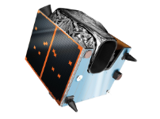
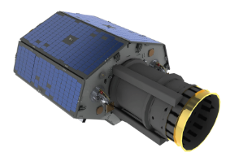
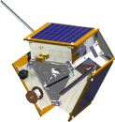
Innovation and Planning of EO Missions for Society and Policy
Professor Sir Martin Sweeting OBE FRS FREng
Executive Chairman, SSTL
Chairman, Surrey Space Centre
United Kingdom

Slide 2


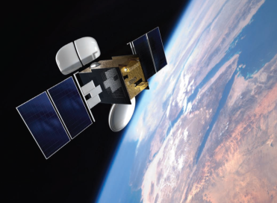
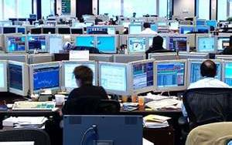
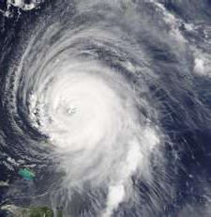
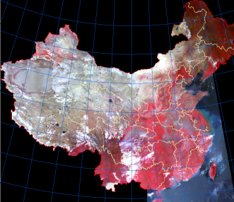



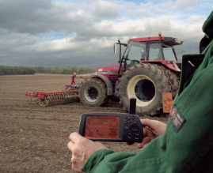
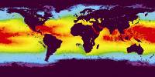

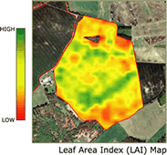

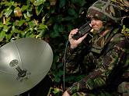
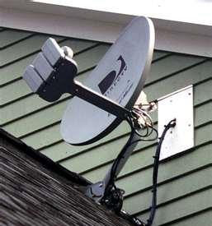
The use of space is expanding …it is an essential infrastructure for our national economies, well-being and security.
Communications
Timing
Agriculture
Disasters

Slide 3
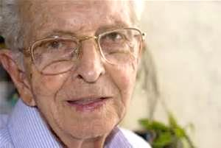



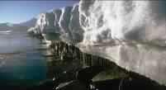
  Key UK challenges to be addressed by space
Growing & ageing population
Increased pace & reach of technology
Global security & terrorism
Natural resources & climate change

Slide 4
  Space technology is now vital to the UK economy
  Space” is one of the UK “Eight Great Technologies” for the UK
  a major growth sector in the UK
  Employing around 80,000 people in a £11 billion industry
  Another 100,000 new jobs expected to be created in the next 20 years
  7% year-on-year real growth, 4x economy average
  A driver of innovation in technology, applications and business

Slide 5

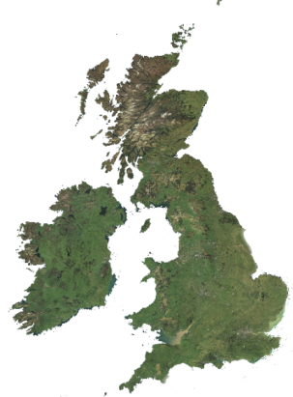
  UK space policy
UK philosophy
  2011 – Innovation & Growth Strategy for space
  Industry, academia, business , HMG (BIS, FCO, MoD & Treasury)
  Realisation of the key role of space in UK economy
  and well being
  Independent Military SatCom – PPP between MoD & Industry
  EO applications ‘Catapult’ to link upstream with downstream users & applications – stimulate new business, especially with non-space SMEs
  Now considering a sovereign EO capability for HMG needs

Slide 6
  UK and Earth Observations
UK is very well surveyed (Ordnance Survey) but need for timely updates of constantly changing environment
Timely monitoring and assessment of:
  increased occurrence of flooding
  future flood risks – particularly in rural areas
  agriculture & land use – urban development
Overseas:
  aid – assessment and co-ordination
  Crown territories
  Support to global security

Slide 7
  UK and Earth Observations
UK government departments
  Many HMG departments use EO but sometimes without realising the information and knowledge is derived from space
  Some departments do not yet realise or appreciate the potential value of EO to achieving their goals or responsibilities
  All departments are concerned that if they admit to the use of data that this will incur additional financial cost to their budgets!

Slide 8
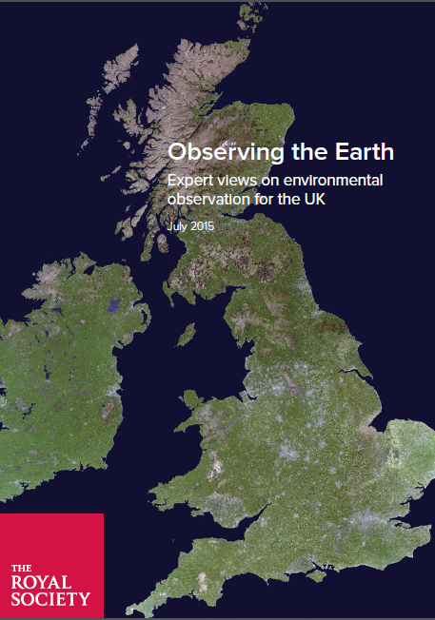
  UK and Earth Observations
The UK Government Office for Science under the Govt. Chief Scientific Advisor commissioned the Royal Society to report on environmental observations for the UK
  Expert panel
  6-month study and report
  how to optimise the use of environmental observation technologies across departments, academia and industry across the UK
  Impact of new technologies, e.g. unmanned vehicles and small satellites

Slide 9
  UK and Earth Observations
Studied:
  Climate Land and freshwater
  Air Natural hazards
  Oceans and ice International
Addressed the strengths, opportunities and challenges for the technology in the next 5 to 10 years and provides examples of how the observations can help meet UK priorities
  Cloud computing Crowd-sourced data
  Opportunistic data automated sensors & IoT
  Autonomous vehicles Small satellites

Slide 10
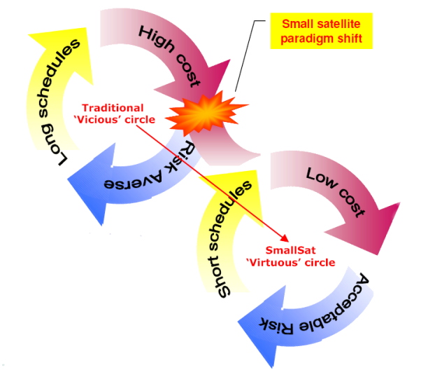
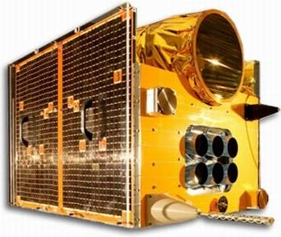




  Innovation in space and its applications
The challenges of space often drive innovation on Earth
Advances in terrestrial consumer electronics has revolutionised the approach to space through COTS – small satellites

Slide 11
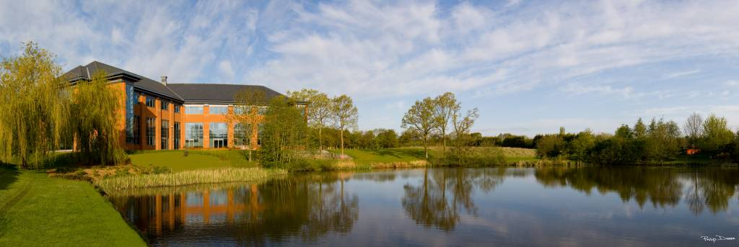

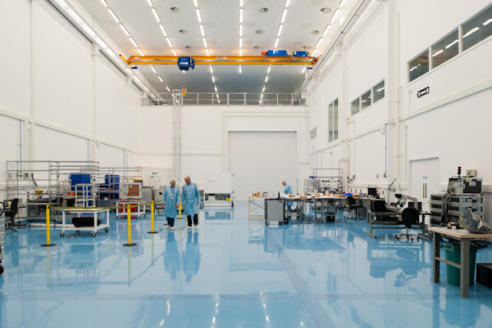
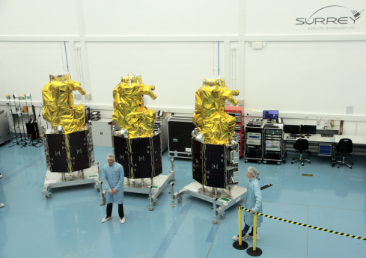
  UK has pioneered advanced small satellites
Synergy of academic research and commercial exploitation
SSTL: founded in 1985 spin-out from University of Surrey
~500 staff in 2015 ~ $150M p.a. turnover ~$0.7Bn exports
SSC: academic research centre ~100 researchers
Synergy of academic research and commercial exploitation

Slide 12
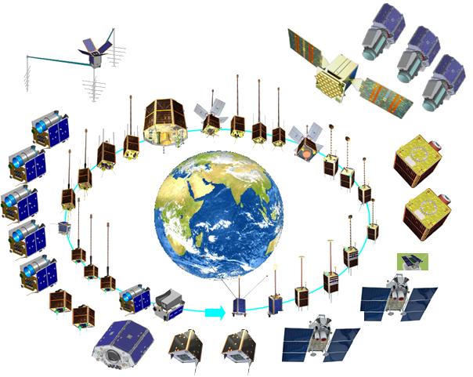


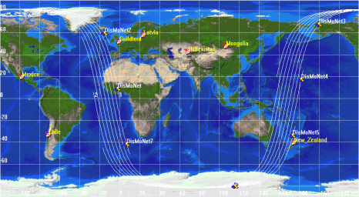
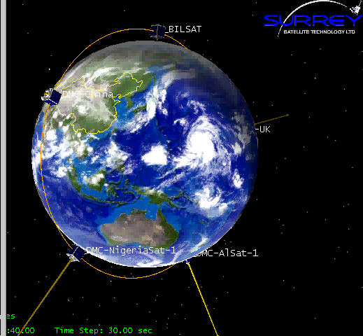
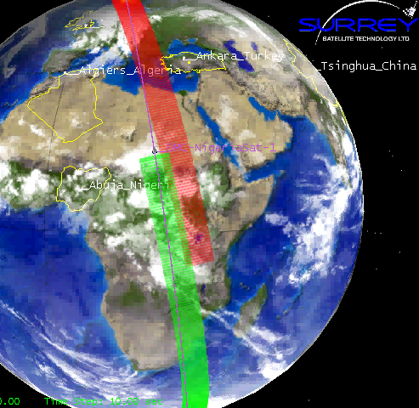
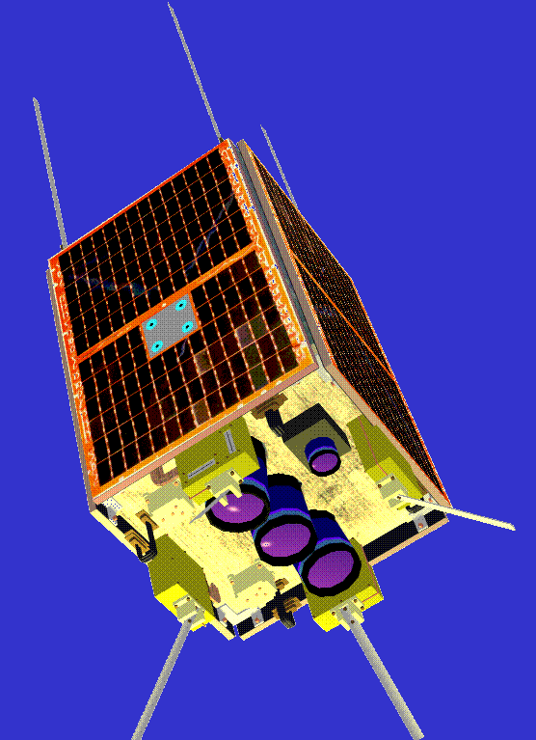
  Surrey has launched 47 satellites in 33 years
  For 10 nations
  International DMC
  Charter contributor
38 of the 47 satellites have carried EO instruments – major part of SSTL business

Slide 13
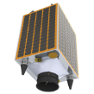

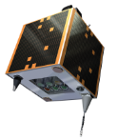
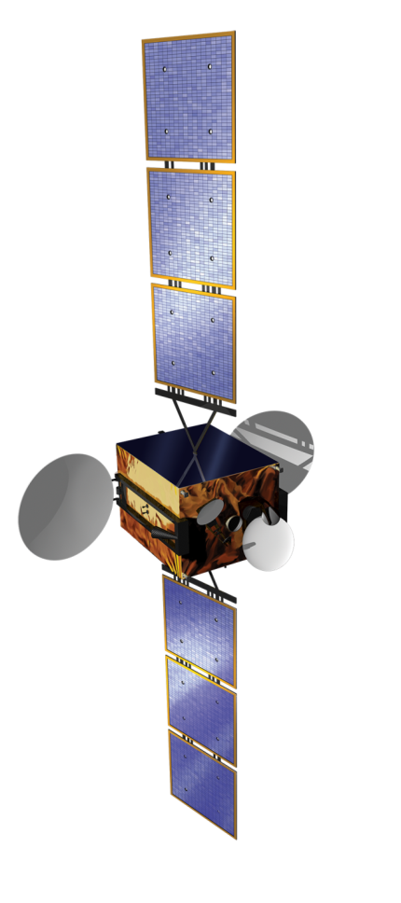
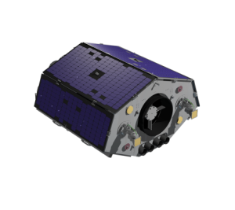
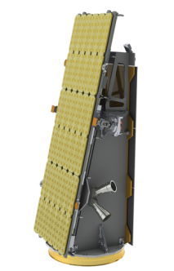
University research to commercial products
Nanosats
SSTL-X50
SSTL 100
SSTL 150
SSTL 300
SSTL 300 S1
UK govt funding approx 1%
HMG RoI 35:1 on EO missions
SSTL NovaSAR
SSTL GEO QUANTUM
4000kg 400kg 150kg 50kg 5kg

Slide 14
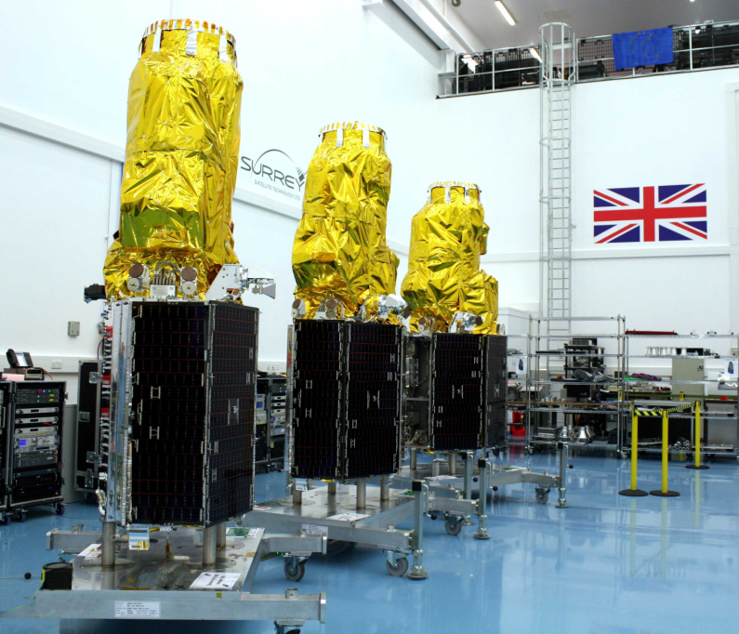
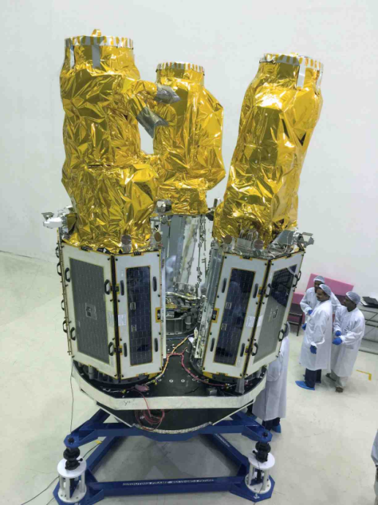
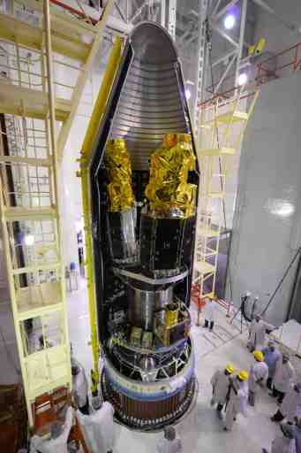
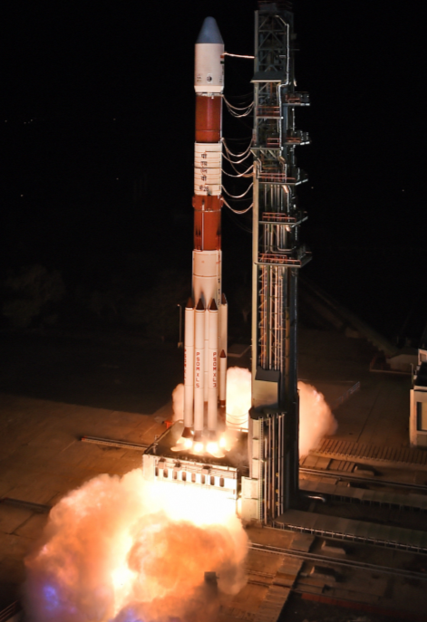
Small EO satellite constellations
SSTL manufacture three EO satellites (430kg, 1-metre GSD)
Launch on Indian PSLV-XL
Leasing imaging capacity

Slide 15
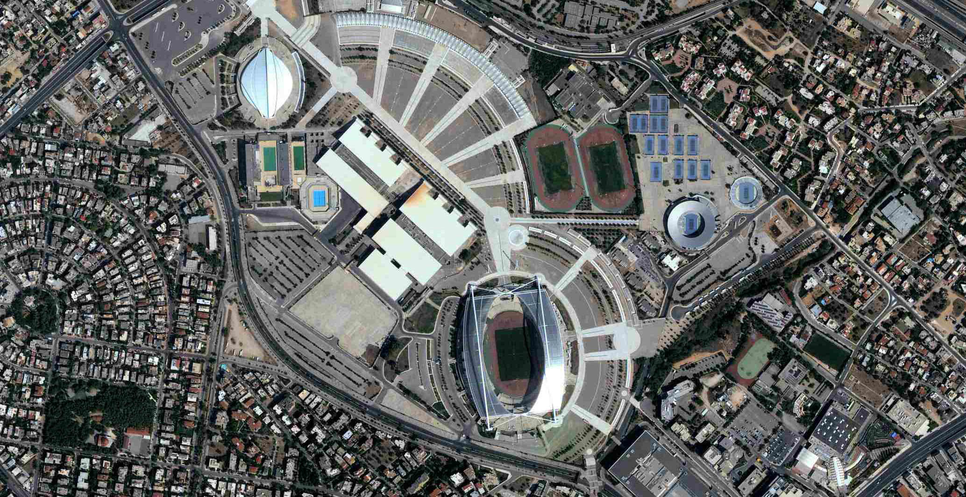
Small satellites are now very capable

Slide 16
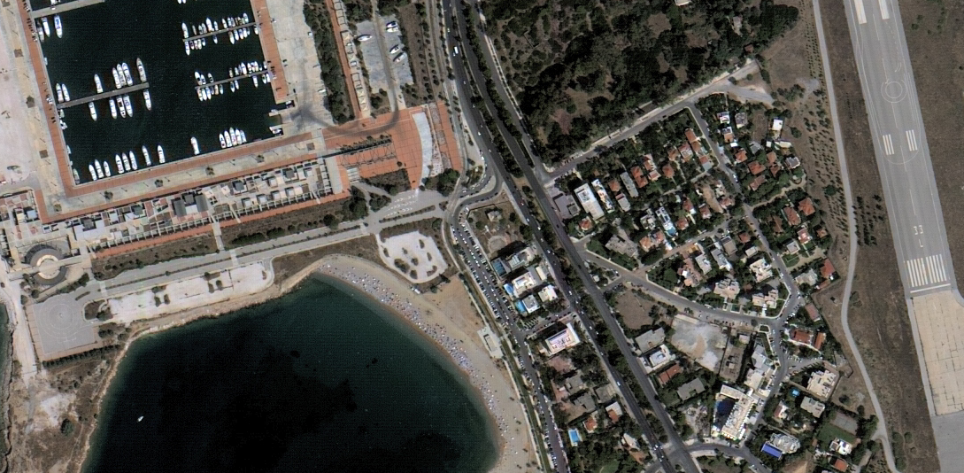

Slide 17
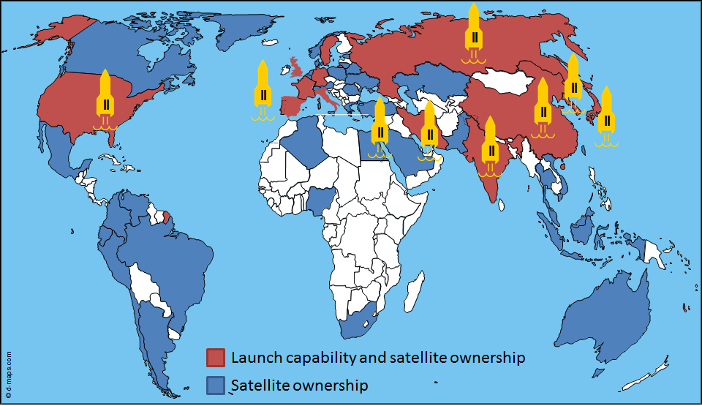
  Earth Observations becoming ubiquitous
Space is no longer the preserve of super-powers or the most technically-advanced or wealthy of nations …
The emergence of small, highly capable but inexpensive satellites has put sophisticated space assets with reach of almost every nation

Slide 18
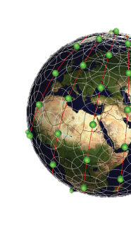
  Implications of EO small satellites
Lower costs
Constellations – affordable
Greater revisit – persistence
More data – global data base – rapidly changing phenomena
More layers – new applications & business models

Slide 19
  International Earth Observations
National programmes for local priorities
International programmes for global surveys
Long-term decadal surveys with data continuity essential
Instrument and data compatibility key
New ‘mega-constellations’ may dramatically increase temporal resolution
‘Big Data’ challenges to extract knowledge from space & non-space sources
International co-operation and export polices

Slide 20

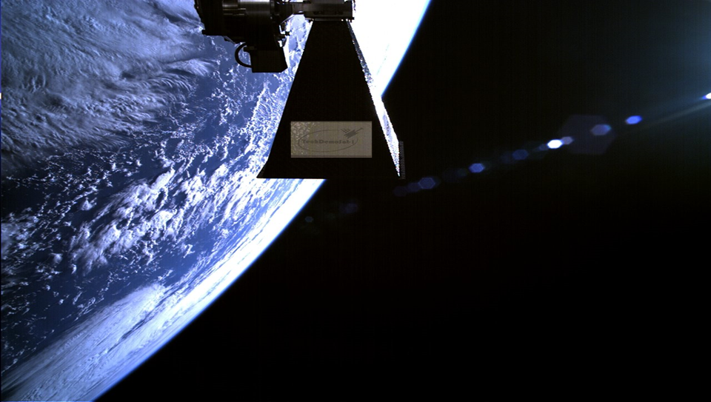

Thank you

