Slide 1
Satellite Earth Observations & Policy
Remarks for “ Assessing the Impact of Satellite Earth Observations on Society and Policy,” Tokyo
9 November 2015
Molly K. Macauley, Vice President for Research and Senior Fellow, RFF

Slide 2
With gratitude to:
NICT
Keio University
Hosei University
JAXA, JST
Resources for the Future, Washington, DC
The Workshop Organizers

Slide 3
Actionable science and information from EO
Science and information for policy (a path of action)
Projections and forecasts
Close to real-time adaptive management or identifying deviation in long-term trends
Improving spatial/spectral/temporal resolution (and better characterization of uncertainty) in data/observations and models
Regular use by media and interested public in E.O. data and capacity to visualize quantitative data
Cyberinfrastructure

Slide 4
US Policy for Earth Observations

Slide 5
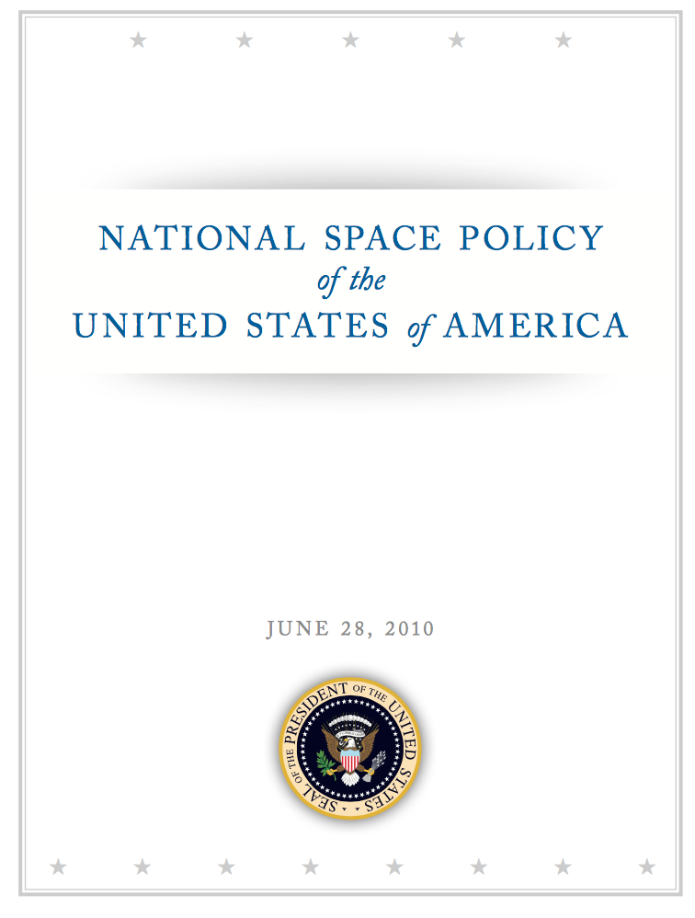

Slide 6
The United States hereby renews its pledge of cooperation in the belief that with strengthened international collaboration and reinvigorated U.S.leadership, all nations and peoples—space-faring and space-benefiting—will find their horizons broadened, their knowledge enhanced, and their lives greatly improved.
Goals include:
Expand international cooperation on mutually beneficial space activities to: broaden and extend the benefits of space; further the peaceful use of space; and enhance collection and partnership in sharing of space-derived information.

Slide 7
Other specifics:
Promote the adoption of policies internationally that facilitate full, open, and timely access to government environmental data
Identify Areas for Potential International Cooperation. Departments and agencies shall identify potential areas for international cooperation that may include, but are not limited to: space science; space exploration, including human space flight activities; space nuclear power to support space science and exploration; space transportation; space surveillance for debris monitoring and awareness; missile warning; Earth science and observation; environmental monitoring; satellite communications; GNSS; geospatial information products and services; disaster mitigation and relief; search and rescue; use of space for maritime domain awareness; and long-term preservation of the space environment for human activity and use.

Slide 8
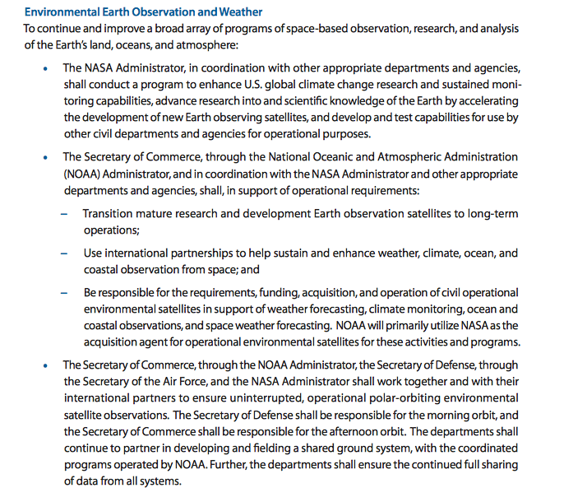

Slide 9
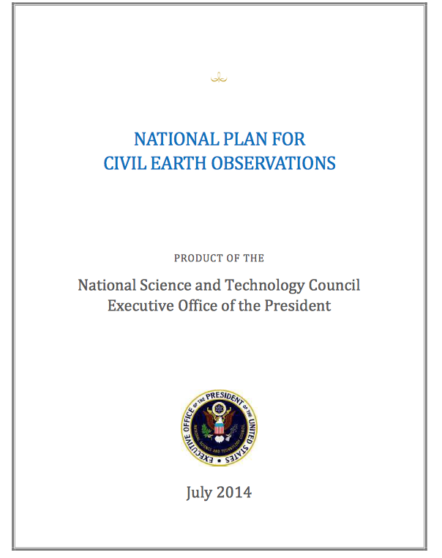

Slide 10
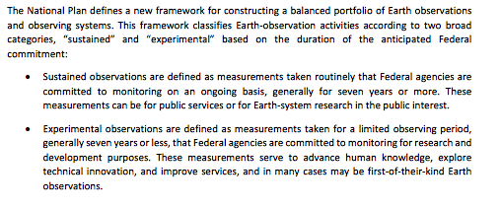

Slide 11
4.2.7. Action 7: Maintain and Strengthen International Collaboration
The global nature of many Earth observations and the value of these observations to U.S. Government
decision makers require U.S. agencies to carry out their missions through collaboration with foreign
agencies, international organizations, and standards/coordination groups. Through international
collaboration, U.S. agencies leverage foreign data and scientific expertise to improve their understanding
of remote areas, such as the open ocean and polar regions, and to characterize global atmospheric,
oceanic, and terrestrial phenomena. In addition, collaboration with international partners helps to
minimize unnecessary redundancy in the collection of Earth observations, and ensures the effective use
of limited resources. U.S. agencies also work closely with the Department of State and other agencies to
provide associated scientific and technical support for U.S. foreign policy, security, economic, and
environmental interests.

Slide 12
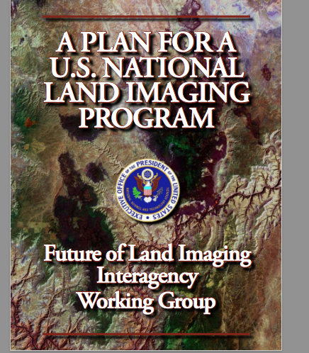

Slide 13
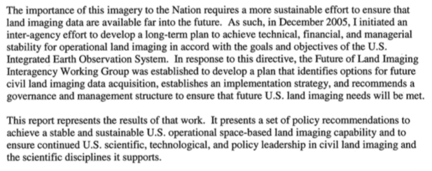
August 2007, John H. Marburger III

Slide 14
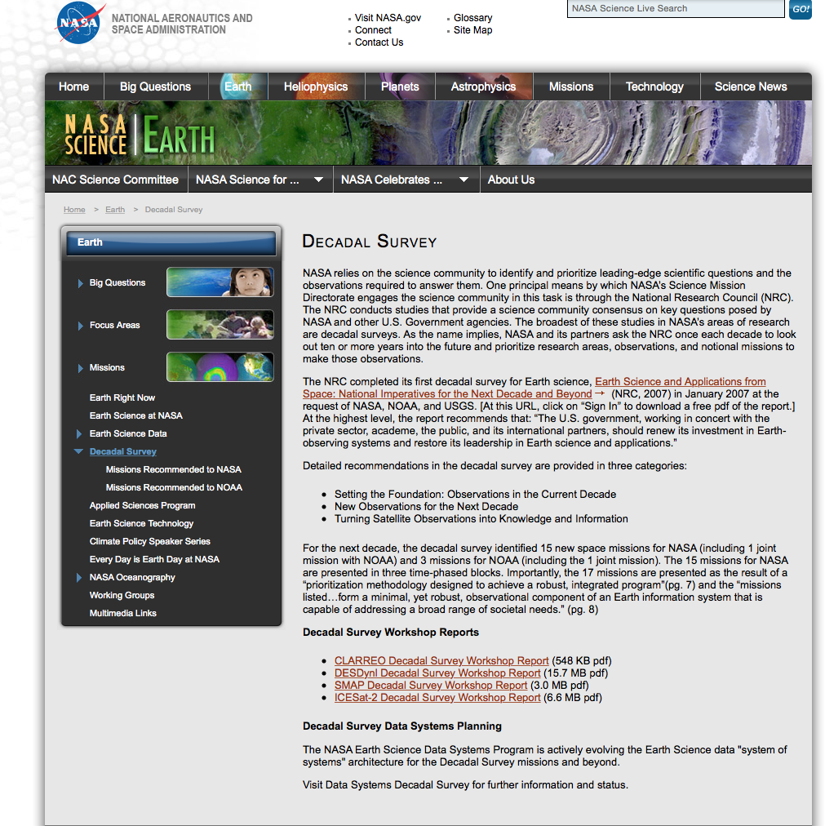

Slide 15
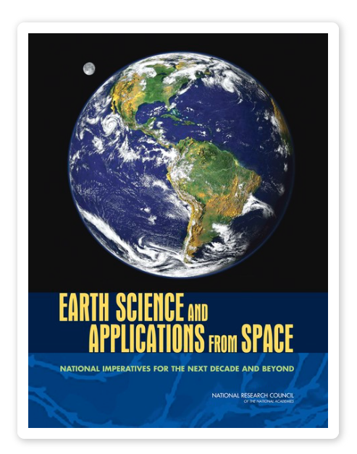
2007

Slide 16
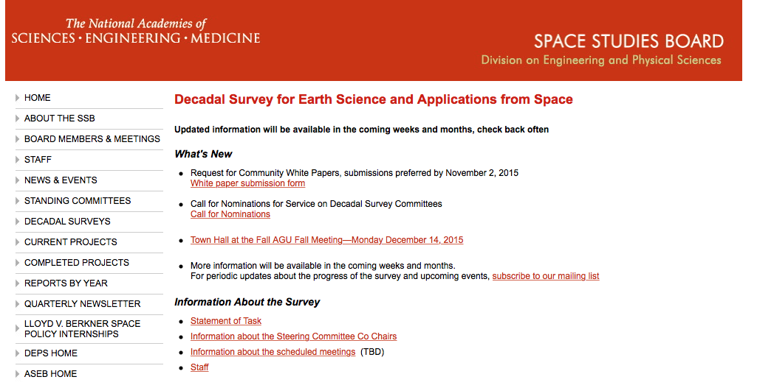
“The survey’s prioritization of research activities is expected to be based on the committee’s consideration of identified science priorities; broad national priorities; an independent assessment of cost, budget and technical readiness; the likely evolution of new technologies; and opportunities to leverage related activities as well as consideration of interagency cooperation and international collaboration. The principal sponsors of the survey are NASA, NOAA, and the USGS.”
http://sites.nationalacademies.org/ssb/currentprojects/ssb_166359#SOT

Slide 17
“The survey’s prioritization of research activities will be based on the committee’s consideration of identified science priorities; broad national operational observation priorities as identified in U.S. government policy, law, and international agreements (for example, the 2014 National Plan for Civil Earth Observation) and the relevant appropriation and authorization acts governing NASA, NOAA, and USGS; cost and technical readiness; the likely emergence of new technologies; the role of supporting activities such as in situ measurements; computational infrastructure for modeling, data assimilation, and data management; and opportunities to leverage related activities including consideration of interagency cooperation and international collaboration. As the committee starts its work it will be provided the guidance contained in Appendix A. The survey committee will work with NASA, NOAA, and USGS to understand agency expectations of future budget allocations and design its recommendations based on budget scenarios relative to those expectations. The committee may also consider scenarios that account for higher or lower than anticipated allocations.”
http://sites.nationalacademies.org/ssb/currentprojects/ssb_166359#SOT

Slide 18
e. The committee may also identify potential interagency and international synergies; proposed augmentations to planned international missions; and adjustments to U.S. missions planned, but not yet implemented.

Slide 19
Use of Earth Observations for Policy

Slide 20
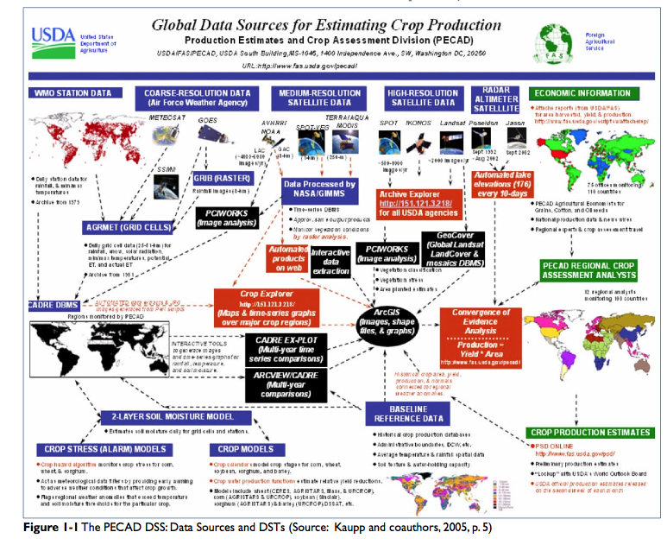

Slide 21
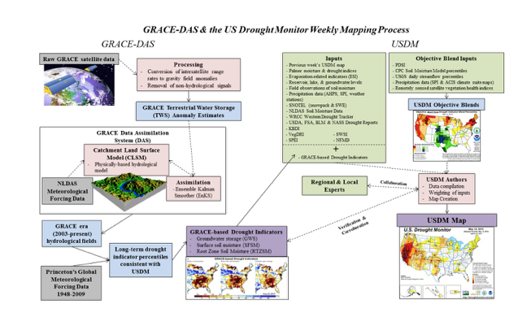

Slide 22
C cycle science, Earth observations and policy
Atmospheric-Ocean General Circulation Models
Integrated Assessment Models
Demographics, land variables/forest carbon poorly modeled and measured with global consistency; Earth system missing
Stabilization Goals
(parts/million or % reduction from baseline)
Policy Effectiveness
--Objectives met
--At what cost
-- Example: adjusting the “social cost of carbon” (US EPA)
Policy Elements and Economy’s Response
Example: Setting the “social cost of carbon” (US EPA)

Slide 23
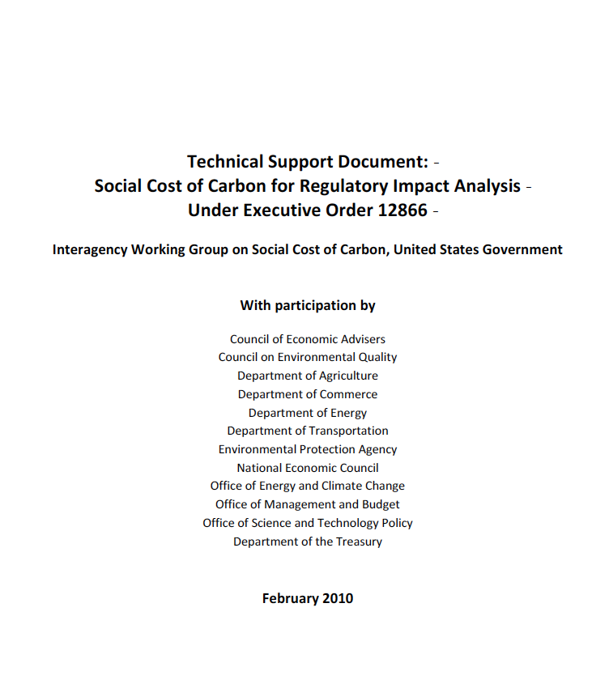
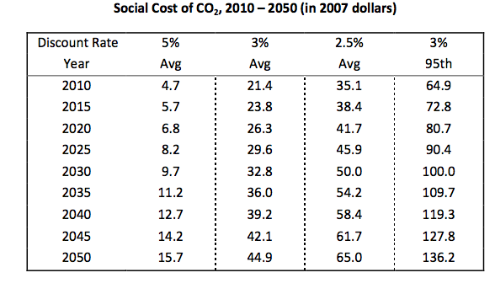
Atmospheric-Ocean General Circulation Models
(NOAA, NCAR, NASA, UK Met Office Hadley Centre, Max Planck Institute, CSIRO (Australia), Bjerknes Center (Norway), Institut Pierre Simon Laplace (France), Russian Academy of Sciences)
-- Climate data and their calibration
-- Models and model assumptions
--Computing power and computational algorithms
Integrated Assessment Models
(MERGE, MiniCAM, IGEM, EPPA, ADAGE, FUND, DICE, PAGE)
-- Climate, economic, demographic, technology data
-- Behavioral and technology assumptions
-- Other policy interactions

Slide 24
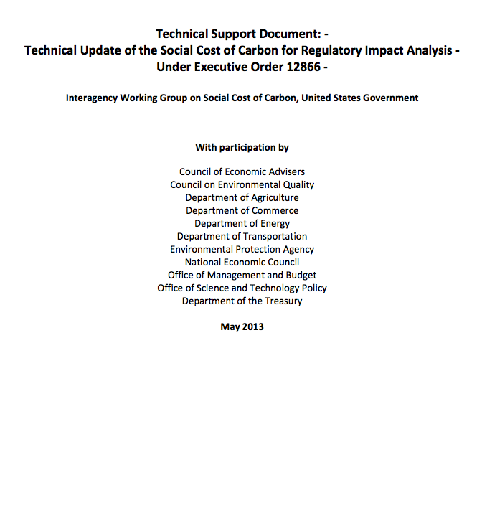
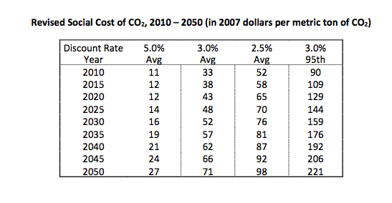
Revised due to new science

Slide 25
PRELIMINARY DO NOT QUOTE
VOI: BAU -> DICE Optimum @ 0.2C/decade
with 95% certainty: |  | mean damages [Trill USD 2015] | stdev
 | BAU 2.5% | 40.08 | 18.55
 | BAU 3% | 24.61 | 10.95
 | BAU 5% | 5.48 | 2.06
Discovered by EO | VOI-EO 2.5% | 8.32 | 4.19
 | VOI-EO 3% | 6.22 | 2.36
 | VOI-EO 5% | 2.56 | 0.43
Discovered by Alternative | VOI-A/C/I 2.5% | 10.74 | 4.74
 | VOI-A/C/I 3% | 7.88 | 2.51
 | VOI-A/C/I 5% | 3.06 | 0.37
Mean averted damages by switching with EO vs AltI [Trill USD 2015], BAU ->DICE Opt. 95% confidence, 0.2C/decade trigger
discount rate
2.5% | 2.43
3% | 1.66
5% | 0.50
Preliminary
Wielicki, Young, and Cooke DRAFT 2012

Slide 26
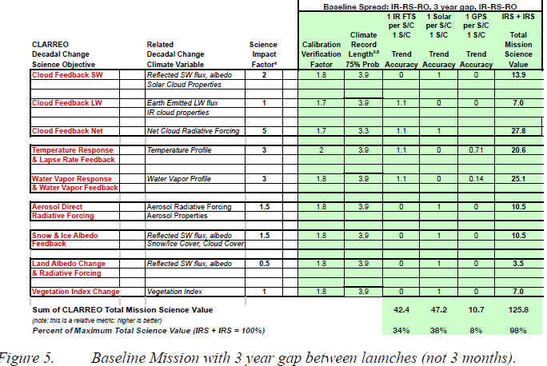
Science for new applied knowledge to inform policy
IPCC
CLARREO Science Value Matrix, Wielecki et al

Slide 27
The Value of Earth Observations

Slide 28
Principles in Value of Information (“VOI”) for EO
Information has value if it can either make a current choice more secure and confident or if it can reveal a different choice as better than the current choice
Information may lead to recognition that there is more uncertainty than initially thought
Information has value even if it introduces more uncertainty (it reveals that what was thought to be certain may not be)
Perfect information may not be worth the cost of acquisition
Some attributes of information may confer more value than others (e.g., spatial, temporal, and spectral resolution; accuracy, precision, and other statistical properties of the distribution of information)
Information tends to have value if it enables an action or a decision not to take action
Information once acquired is available at low additional cost, and one person’s use may not preclude another person’s use. Some information is about goods and services for which we have no prices.

Slide 29
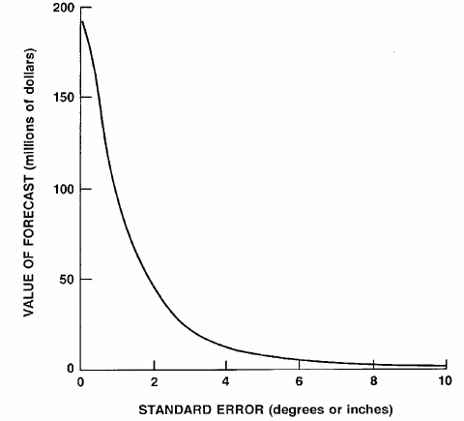
Parameters of the information matter
Agnew and Anderson 1977

Slide 30
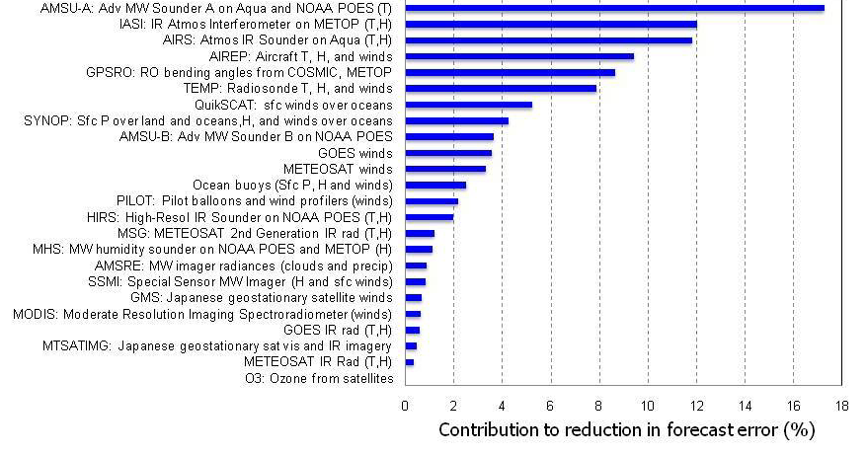
NRC, 2012, p. 17 -- courtesy of European Centre for Medium Range Weather Forecasts.

Slide 31
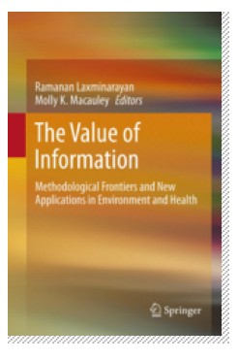
Incorporating VOI analyses: some methods and examples
Regulatory cost-effectiveness
Implementation of land use and air quality regulation (Bernknopf et al. 2012)
Monitoring water quality (Bouma, van der Woerd, et al. 2009)
Econometric modeling and estimation
Productivity (agriculture; Tenkorang and Lowenberg-DeBoer 2008)
Years of life expectancy (Obersteiner et al. 2012)
Other quality of life dimensions
Simulation modeling and estimation

Slide 32
Methods and examples, cont’d
Price- and cost-based derivation
Weather data for weather insurance (Osgood, 2012)
Drought and land use information for index insurance (Skees et al., 2007)
Losses averted from vector-borne disease (Hartley, 2012)
Probabilistic approaches
Bayesian belief networks (Cooke and Kousky, 2012)
Expert elicitation (probabilities of various tipping points, Interagency Working Group on Social Cost of Carbon, p. 32)

